Slide 1
CDISC 360i: Lessons Learned and Road Ahead
Peter Van Reusel, Chief Standards Officers, CDISC.

Slide 2
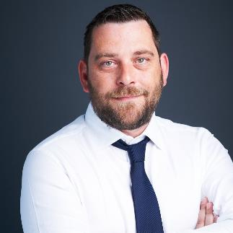
Meet the Speaker
Peter Van Reusel
Chief Standards Officer
CDISC
Peter Van Reusel provides executive leadership to the development and implementation of clinical standards in line with CDISC’s strategy and operational plans, working closely with the President and CEO, as well as CDISC staff and stakeholders.
He has over 20 years’ experience in senior roles in pharma and at CROs, providing standards expertise and carrying out other standards work in various organizational settings. A long-time, CDISC-authorized instructor, Peter has helped significantly in developing CDISC training courses.
He previously served as CDISC’s European Liaison, fostering relationships with key European regulatory, academic, and biopharma stakeholders. Peter is also an active PHUSE collaborator.

Slide 3
Agenda
Purpose & Approach
Achievements, Challenges & Insights
Looking forward: Art of the Possible

Slide 4
Purpose & Approach

Slide 5

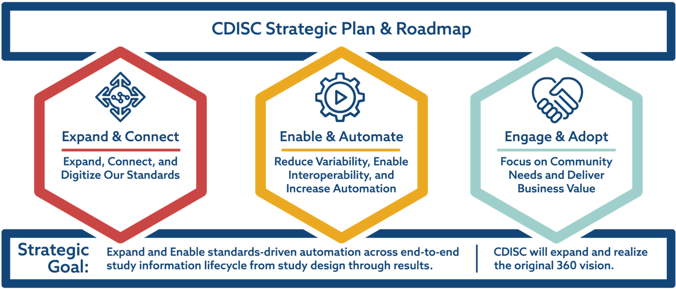
Realizing CDISC's Mission
CDISC’s vision is to amplify data’s impact to advance research by…
creating connected standards across the study information lifecycle to enable accessible, interoperable, and reusable data for more meaningful and effective research

Slide 6

360i Goals
Define and digitalize end to end standards from study design endpoints through the analyses
Leverage those standards to accelerate the study design and build phase of the trial
Demonstrate the automated data flow from raw data source to the generation of the targeted result

Slide 7













360i Focus
Data Standards
Biomedical Concepts Analysis Concepts Foundational Standards
Data Sources
Specifications
Select Biomedical Concepts
Schedule of Activities
Data Collection
Study Team
eDT
Tabulation
Analysis
USDM
EDC
Protocol Outline
Build
Design
DHT
EHR
Extract
Analyze
Output
Tabulation
Datasets
Analysis
Datasets
Results
TFLs
Report
Run

Slide 8
360i Phase 1
Data Standards
Biomedical Concepts Analysis Concepts Foundational Standards
Build
Data Sources
Specifications
Select Biomedical Concepts
Schedule of Activities
Data Collection
Study Team
eDT
Tabulation
Analysis
USDM
EDC
Design
Protocol Outline
DHT
EHR
Extract
Analyze
Output
Tabulation
Datasets
Analysis
Datasets
Results
TFLs
Report
Run

Slide 9
360i Operational Team
88
Operational Steering Committee
15
Design
Build
Run
Co-Leads
Mikkel Traun
Valerie Sheft
Sub-teams
Co-Leads
Sub-teams
Co-Leads
Sub-teams
Data
Lex Jansen
Bess Le Roy
Dianna Di Russo
Christine Connolly
Anthony Chow
Sam Hume
Nicolas de Saint Jorre
Define-XML/Shell Dataset
ODM/CRF/aCRF
Jeremy Teoh
sdtm.oak
Conformance
Study Design Team
Program Manager
Sam Hume
Bess LeRoy
Anthony Chow
Dianna Di Russo
Christine Connolly
Mikkel Traun
Nicolas De Saint Jorre
Valerie Mildred Sheft
Jeremy Teoh
Charles Shadle
CDISC Executive Team
Chris Decker
Peter Van Reusel
Nicole Harmon
Julie Smiley
Co-Leads
Lex Jansen
12
23
16
Parallel Focus Teams
BC Curation
CDISC Open Rules
Analysis Concepts
TMF Digital Model
26
Reviewers
> 40

Slide 10
Achievements, Challenges & Insights

Slide 11



Design
Insights
Achievements
Linking concepts works, but concept groupings are needed for usability
Collection method
Data type
Category
Analysis
Open-Source USDM SoA authoring tool is needed
Detailed user stories for Study Design and Study Amendment
Digital Schedule of Activities linked to biomedical concepts
Challenges
Interpreting LZZT protocol information to identify what data is needed
Fit for purpose Study Design software

Slide 12








Study Design Applications Used
Used hosted sandbox
Can be overwritten/altered
OSB GUI
Objects
Endpoints
SoA
BCs
Etc.
No BCs
Missing BCs
Digital SoA linked to Biomedical Concepts
Excel
Hosted solution out-of-date
Used GitHub version locally

Slide 13
Build Define.xml and Shell Datasets
Insights
Achievements
To fully automate, we need to add study specific operational metadata
Develop an updated Data Definition Specification (DDS) standard (Define.JSON)
Used BCs from USDM JSON and query CDISC library for dataset specializations
Identified all metadata for automation
Challenges
Large process flow to achieve full automation
Work-arounds needed to obtain all needed operational metadata

Slide 14
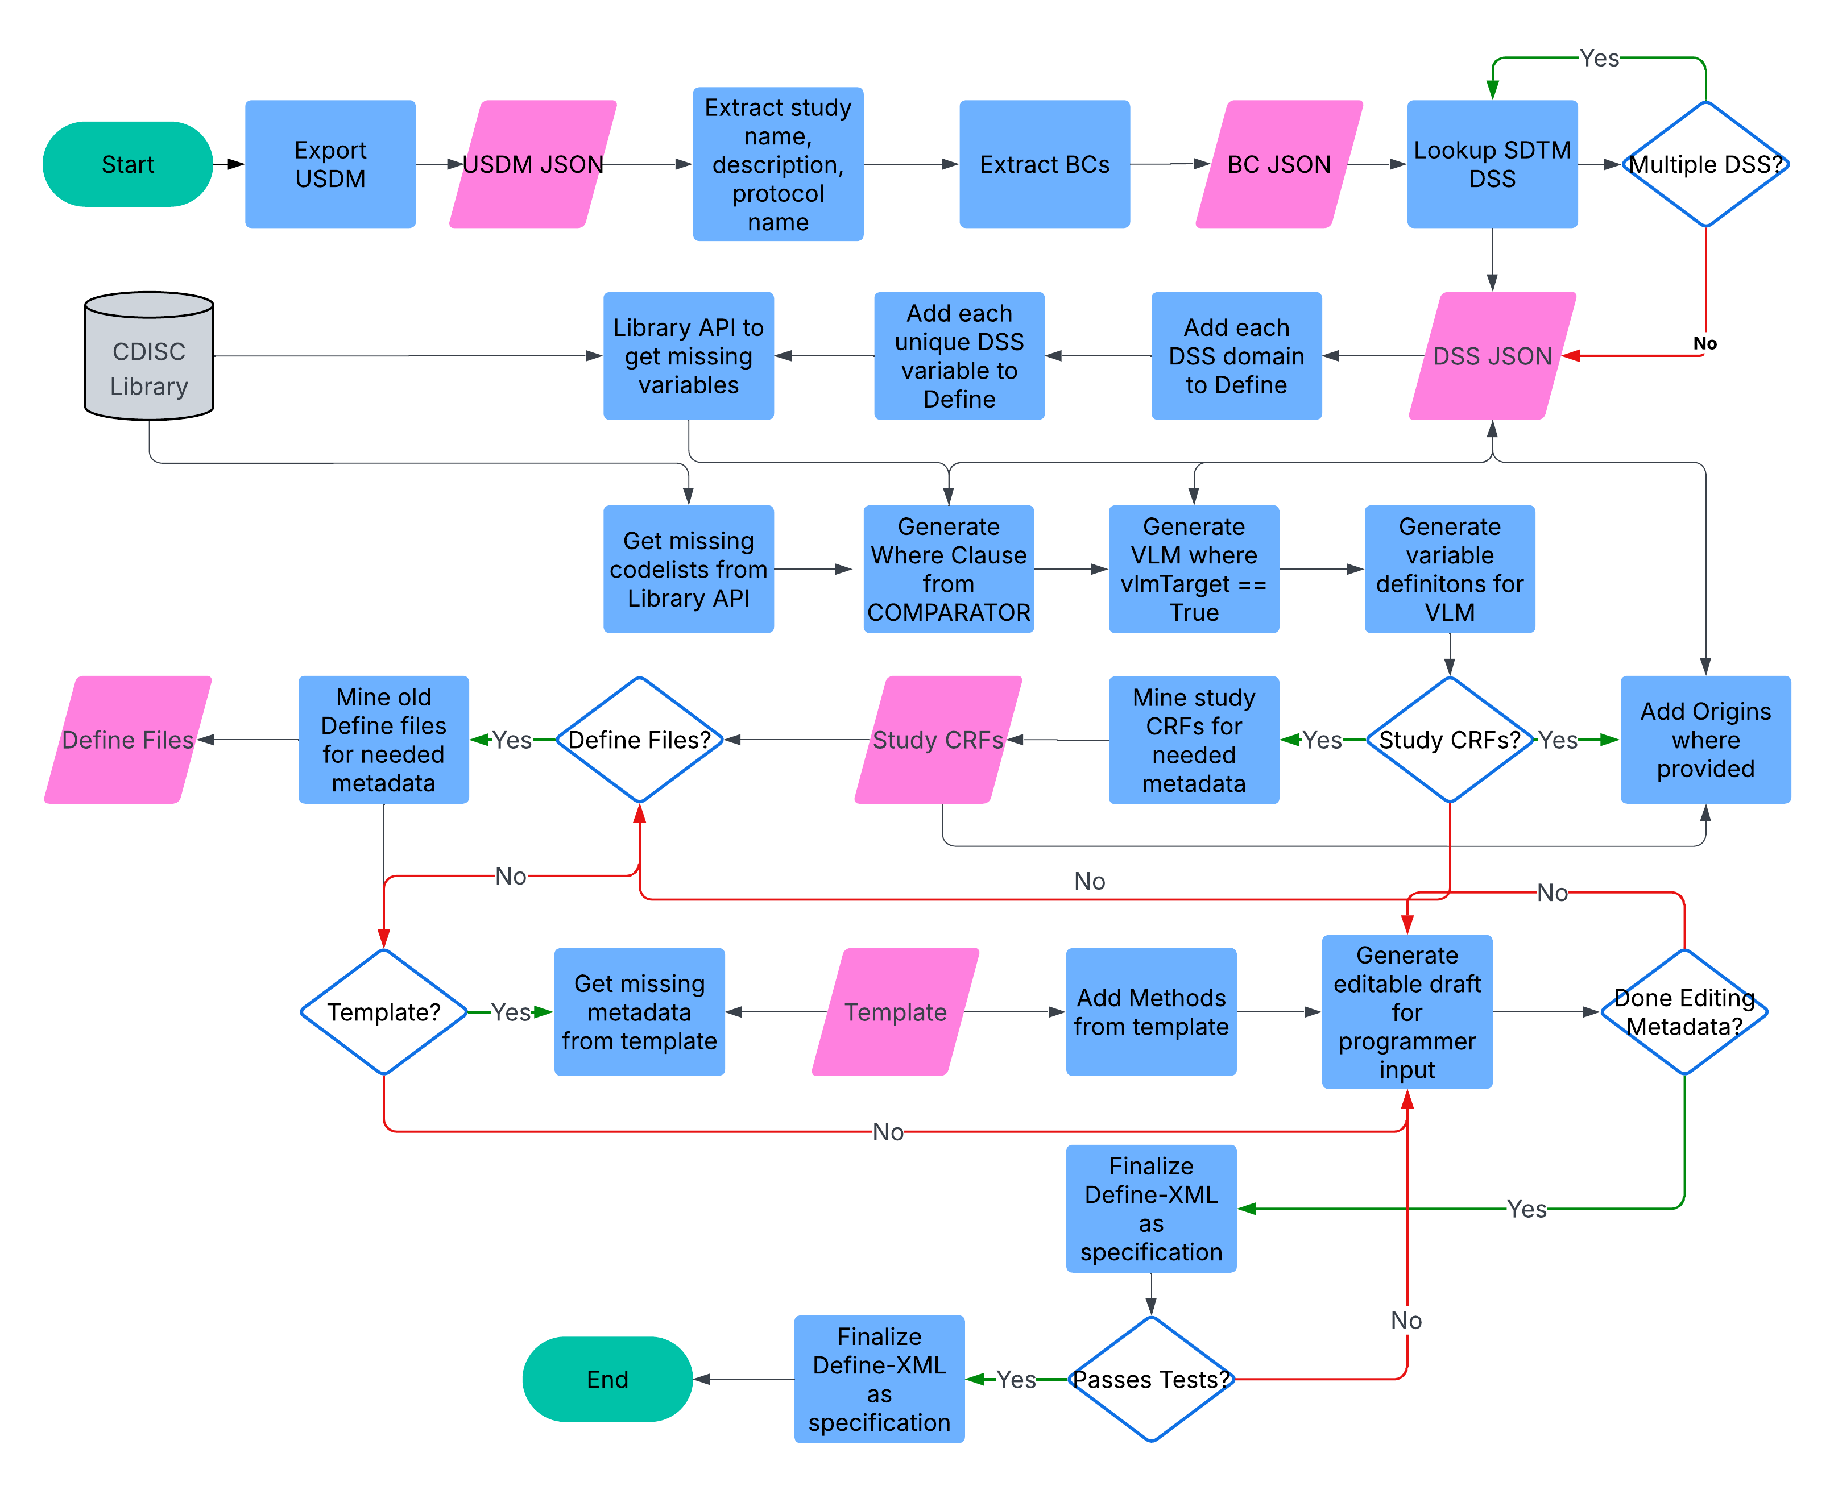
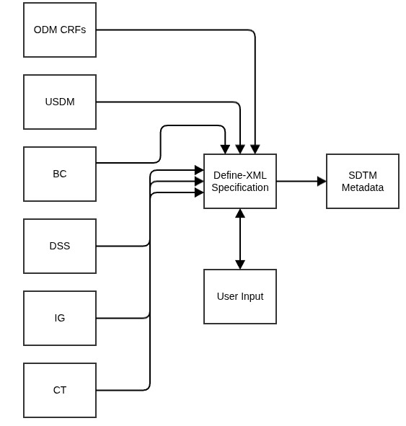
Define-XML Metadata flow
High-level Data Flow
Detailed Data Flow

Slide 15
Insights
Build CRFs and Annotated CRFs
Achievements
Biomedical Concept groupings and CRF specializations are needed
Additional forms metadata are needed
To fully automate, we need to add study specific operational metadata
Generation of ODM file of the necessary structures
Generation HTML rendition of CRFs and annotated CRFs
Challenges
CRF specializations under development and not available in CDISC Library
USDM does not provide forms metadata
Need to use a workaround (xlsx spreadsheet)

Slide 16
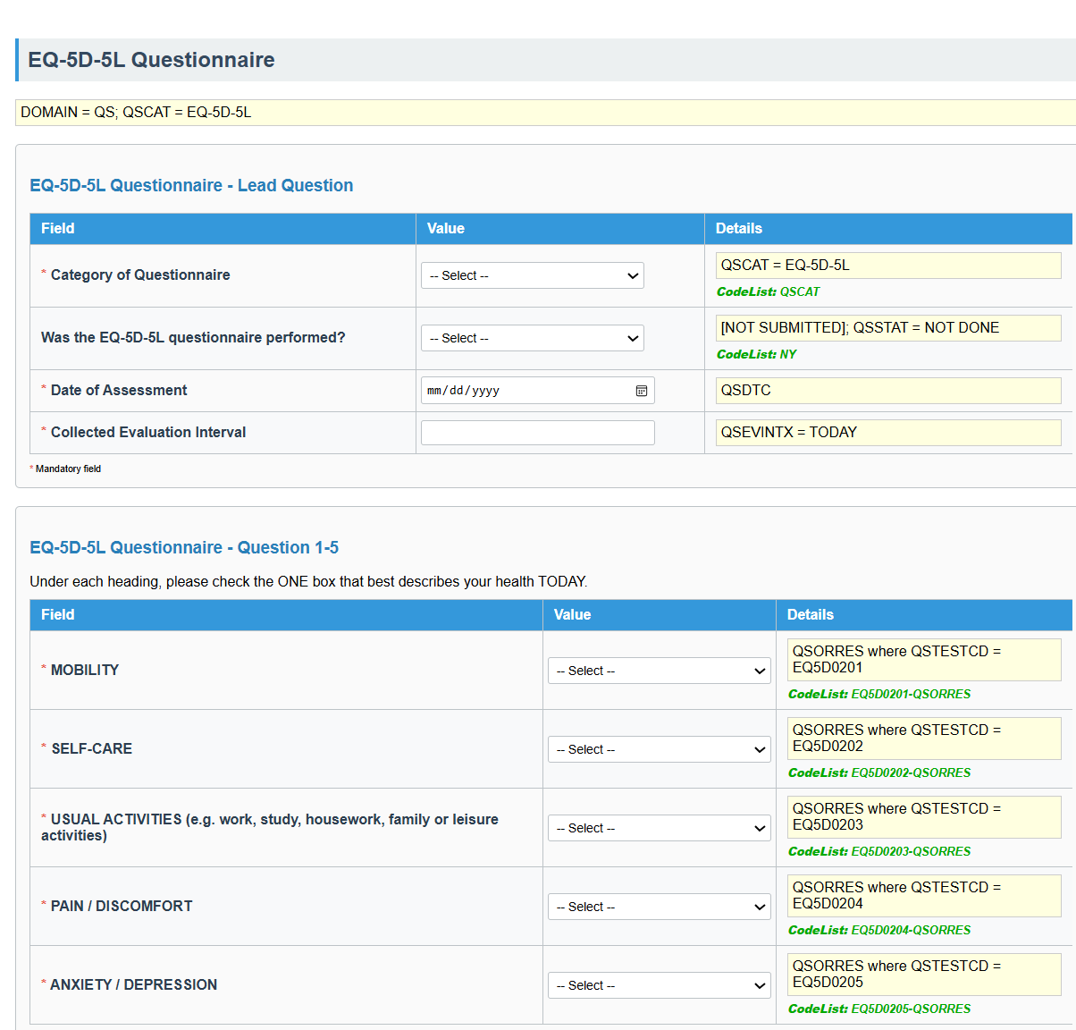
Annotated CRF Generated from Biomedical Concept

Slide 17
Run – Generate SDTM datasets from source
Insights
Achievements
Need for tool-agnostic transformation logic between data collection and tabulation
Need to develop an ingestion filter for non-standard source data
Need to demonstrate the data flow through the entire pipeline
Generation of multiple SDTM datasets using the SDTM.OAK open-source R package
Challenges
Dealing with non-standard , non-tabular data
Limited source data

Slide 18
Run - SDTM Datasets with SDTM.OAK
Metadata
Metadata-Driven Mapping
Map Pseudo Variable to SDTM Variable
Assign OAK Algorithm
Assign Parameters
Assign Controlled Terminology
Build R Code
Data Collection Specs
SDTM Data Specs, VLM
Controlled Terminology
Intermediate Data Structure (Non-Std/Complex Mapping)
Run and Output SDTM Dataset
Prep/Categorize for Intermediate Structure
Assign Pseudo Variable Names and Types
Output
Intermediate Dataset
SDTM.OAK Algorithms
Agentic AI and ML framework

Slide 19
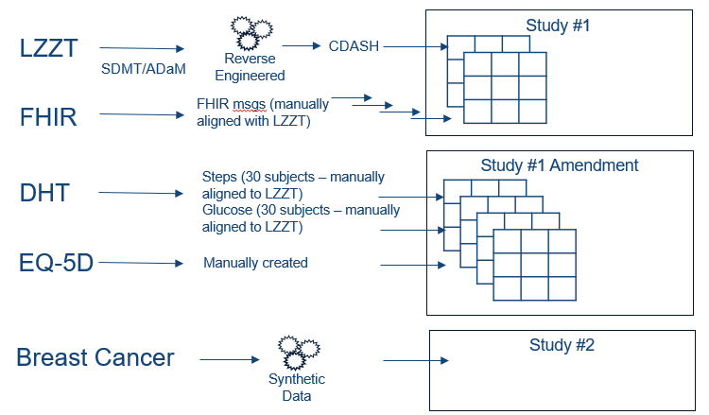

Run – preparing source data
Started with CDISC pilot data
Reverse engineered source data
Manual aligning with LZZT data
Created aligned FHIR messages
Lots of help from the Community
Notes:
Study
LZZT: We started with the CDISC Pilot study data but we only had SDTM and ADaM data so one of the community created reverse engineered collection data.
FHIR: While the original study had DILI data, we wanted to show how FHIR could play a part in the lifecycle, so another partner in our community created LZZT aligned FHIR messages.
We used FHIRPath for our mapping but the work by the RWD Lineage project shows equally interesting approaches we might leverage in the future
Amendment
DHT: In order to address the amendment use case, we asked for DHT data.
One community partner was able to give us step data for 50 patients.
Another was able to give us glucose data for 2 patients.
Both sets of data had to be aligned to LZZT to emulate it as a likely scenario of the study
EQ-5D: We manually created LZZT aligned QRS data.
Breast Cancer:
A community partner was able to synthesize breast cancer data for us.

Slide 20
Looking Forward: Art of the Possible

Slide 21
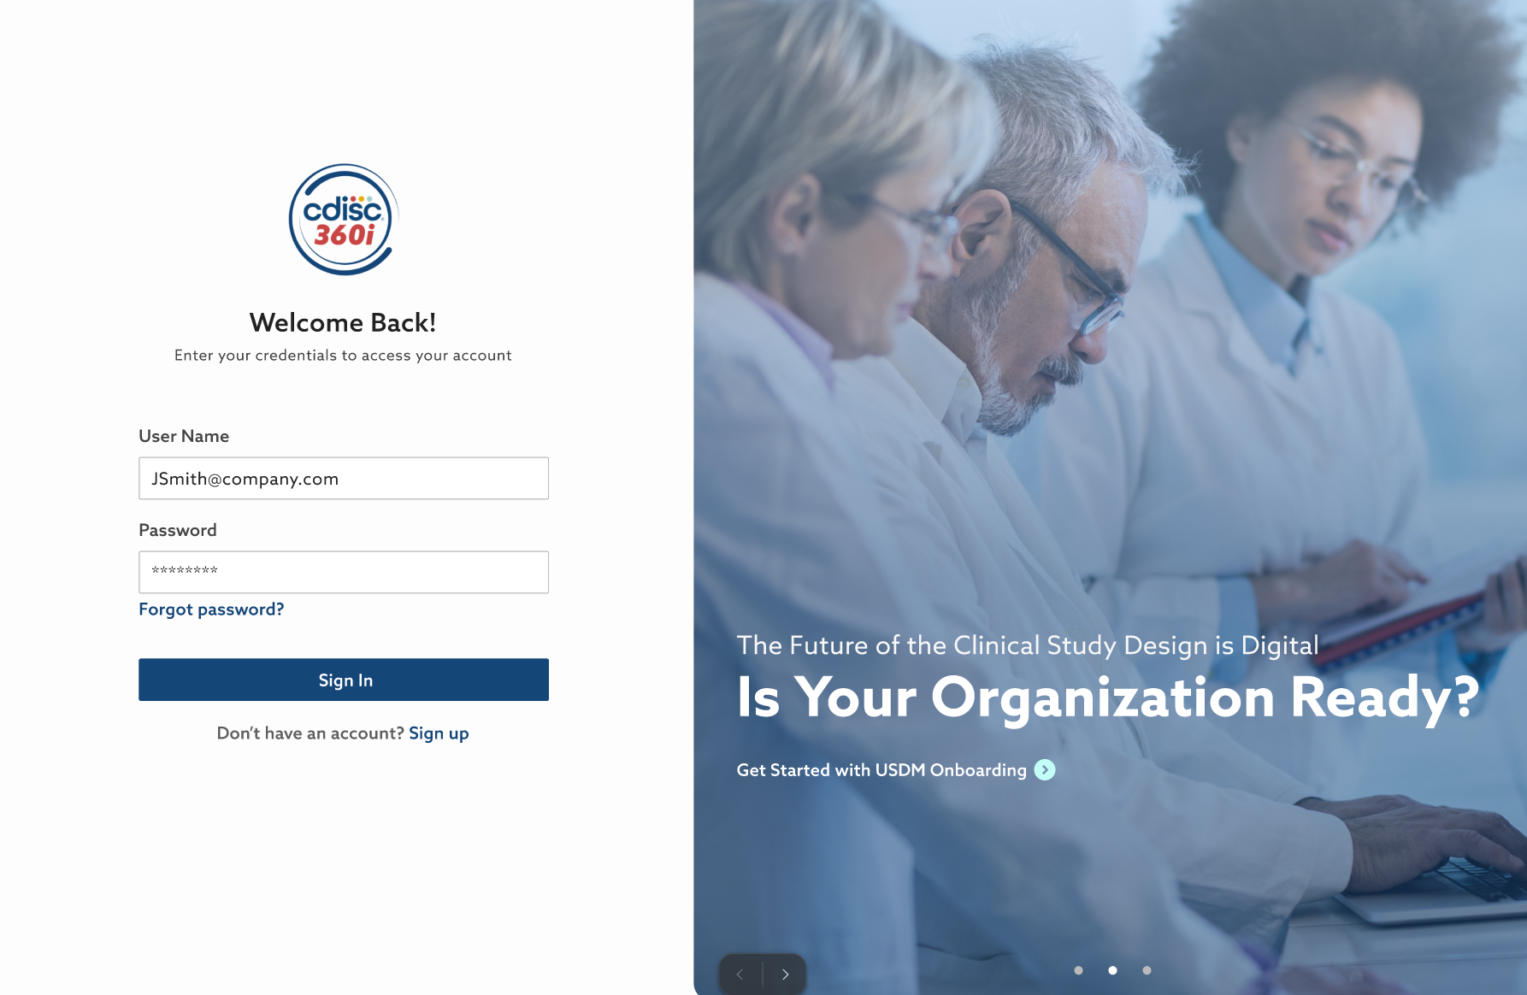

Slide 22
Art of the Possible
Purpose of this Prototype
This is a conceptual UX Design
It illustrates how CDISC Standards could be experienced in an integrated environment
Not functional softwared, but a visual representation
Helps visualize the potential of standards-driven end-to-end automation
CDISC_Final – Prototype
Prototype password: CDISC2025

Slide 23
CDISC 360i Phase 2: What’s next

Slide 24
360i Phase 2: Operationalizing the Vision
Key Deliverables
Digital Protocol & Impact Analysis Reporting: Machine-readable protocol model with automated amendment and impact analysis
Standardized Analysis Concept Model: Configurable, machine-readable analysis concepts driving automated analysis artifacts
Automated eCRFs, Define & Dataset Generation: Generation of eCRFs, Define.xml and datasets integrated with study workflows
Digital Data Transfer Agreement Model: Technical DTA model and standardized template aligned with the digital protocol
Notes:
Phase 2 is focused on delivering tangible digital capabilities that move us from foundation to operational execution.
We are delivering four core capabilities in 2026.
First, a digital protocol model with automated amendment and impact analysis reporting — making the protocol machine-readable and traceable.
Second, a standardized, configurable analysis concept model that is machine-readable and capable of driving automated analysis artifacts.
Third, automated generation of Define.xml and datasets integrated directly with study workflows.
And fourth, a digital data transfer agreement model aligned with the digital protocol.
To demonstrate this in a concrete way, we are using a breast cancer progression-free survival endpoint aligned with our “Art of the Possible.”
At US Interchange in October, our goal is to demonstrate selection and configuration of a standardized endpoint and show traceability from digital protocol through analysis artifacts.
This milestone represents our transition from digitizing standards to operationalizing them — and positions us for broader ecosystem embedding in the years ahead.

Slide 25
360i Phase 2 Focus
Data Standards
Biomedical Concepts Analysis Concepts Foundational Standards
Build
Data Sources
Specifications
Select Analysis Concepts
Select Biomedical Concepts
Schedule of Activities
Data Collection
Study Team
eDT
Tabulation
Analysis
USDM
EDC
Protocol Outline
Design
DHT
EHR
Analyze & Output
Extract
Generate
Tabulation
Datasets
Analysis
Datasets
Results
TFLs
Report
Run

Slide 26
Thank You!
Peter Van Reusel
pvanreusel@cdisc.org

